Slide 1


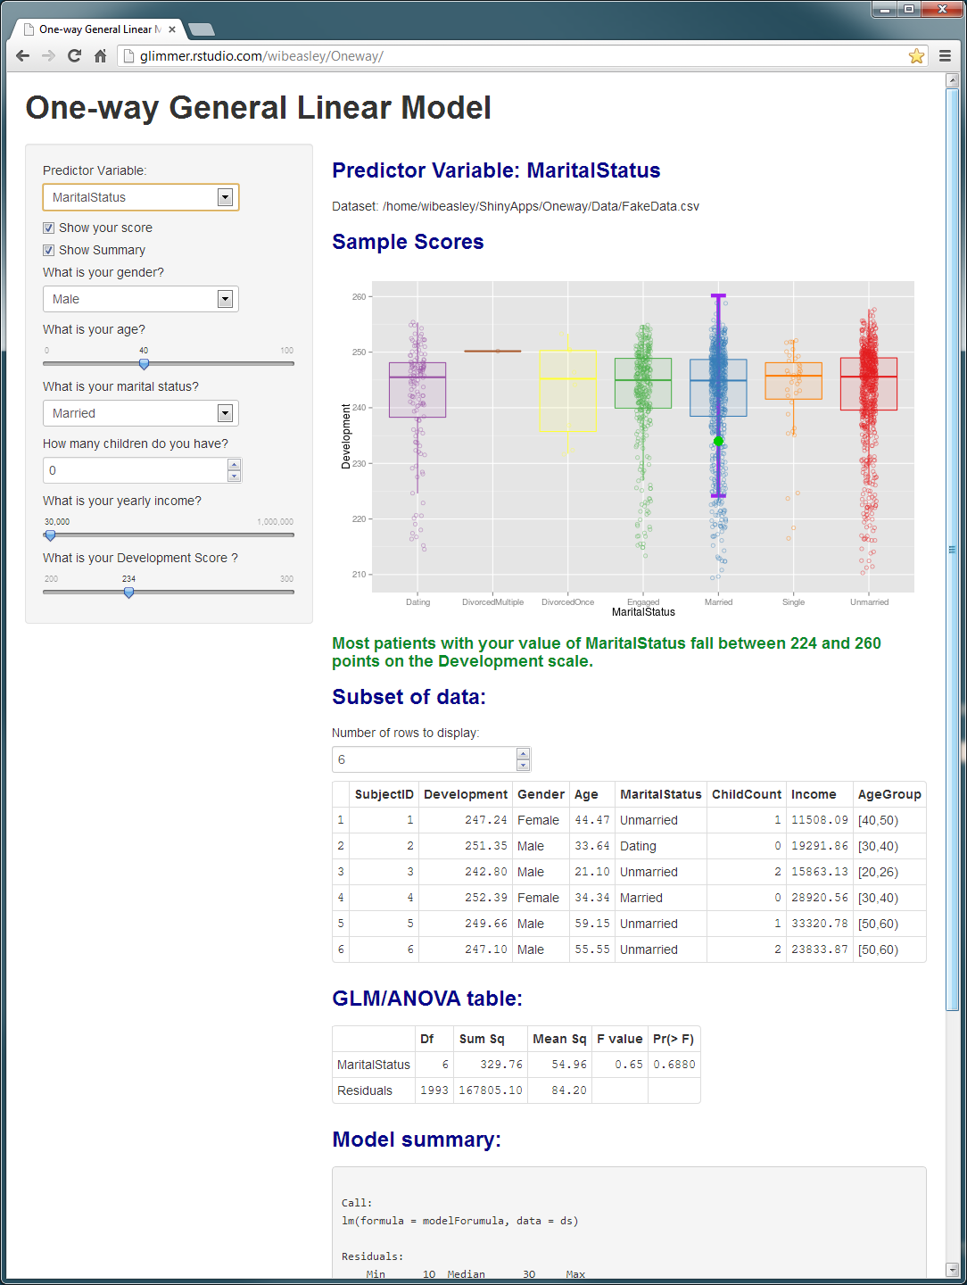
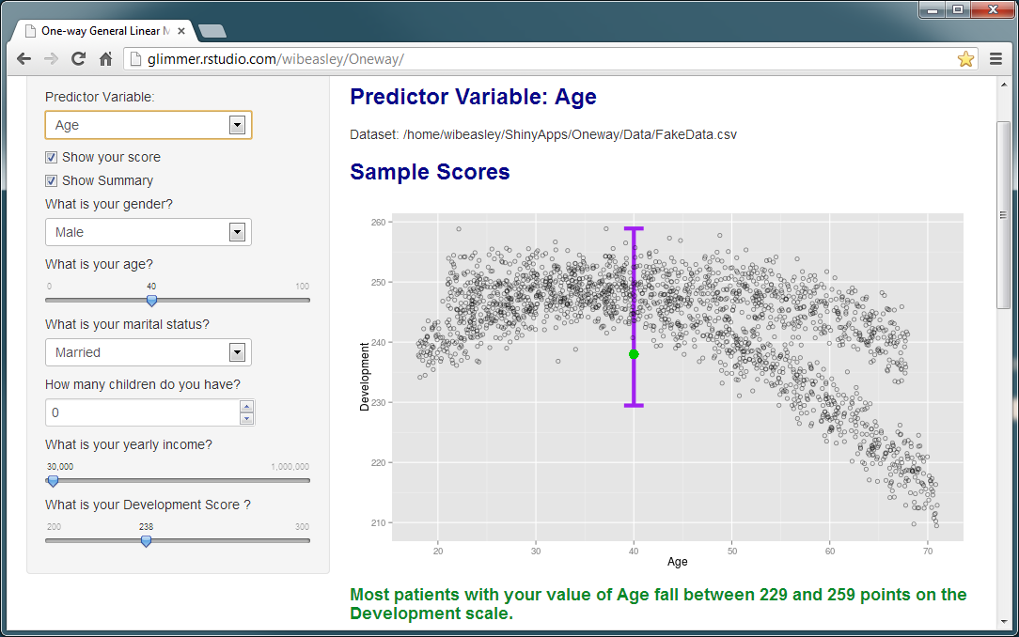
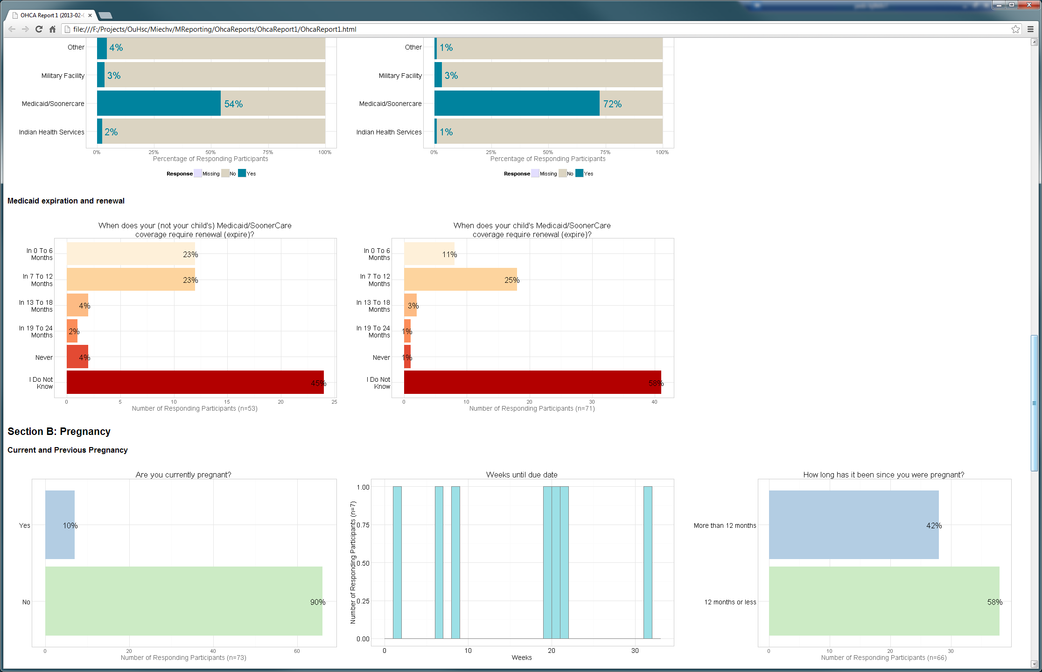
Literate Programming Tools for Continuous Quality Improvement
William H Beasley, David E Bard, & Thomas Wilson
OUHSC, Developmental and Behavioral Pediatrics
Background
Collaboration and Communication within these groups
Interactive Reports
Continuous Quality Improvement (CQI)
Our project serves as the external evaluators for the Maternal, Infant, and Early Childhood Home Visiting (MIECHV) grants, administered by the OK State Dept of Health (OSDH).
HRSA defines CQI as “a continuous process that employs rapid cycles of improvement.” Accordingly, our data system is designed to provide fresh and frequent feedback to the OSDH administration, and its contracted agencies.
This poster describes the tools used in our evaluation; all are freely available to both OUHSC researchers and OUHSC clinicians.
Literate Programming
Combines text, graphs, and statistics in a coherent document that is more easily understood by human readers.
Uses automation to eliminate the need to repeatedly copy & paste analytic results after underlying data sources are updated.
Reproducible Research
Facilitates scientific replication.
Disseminates techniques to other subfields.
Promotes cumulative research.
The 4 statisticians on the project. Version control software (GitHub) allows parallel development of the analytical code. A multi-tiered data access layer allows substantial code reuse, which makes the software development more agile and efficient.
The 20 members of the OUHSC team. Centralized databases (REDCap and SQL Server) allow participant data to be collected and processed securely. Scheduling features within REDCap allow data collectors to manage appointments, and reschedule missed visits. Data collectors carry mobile 3G/4G hotspots to upload and download information during interviews.
The 3 partnering organizations (OSDH, WIC, OHCA). Secure data exchanges allow us to receive their subject-level and agency-level data. Automation and literate programming allow us to distribute summary reports frequently.
Academics in different fields (particularly at OUHSC). Open-source and popular software tools allow us to more easily generalize the workflow to fields that are outside of developmental & behavioral pediatrics. Specifically, we adopt aspects of previous successful clinical research and CQI projects, as well as share the features of our study that might be well-suited for later projects.
Researchers in other states pursuing similar goals. Literate programming allows us to more easily create manuscripts and supplement publications with sanitized datasets that facilitate reproducible research.
Interactive web-based reports can be publically exposed if the content is exploratory in nature, and does not contain PHI. An interactive format allows readers to explore multidimensional spaces, more quickly than if all possibilities were contained in a large paper report. Here is how a diagnostic prediction model could be presented to patients. Their manually-entered values are passed to the prediction engine, whose individualized results are presented with text, graphs, and tables.
Static Reports
When a user clicks the ‘render’ button, the report engine calls an underlying R script that (a) queries the database, (b) manipulates the data, and (c) runs the analyses. These analyses are returned to the reporting engine, which formats the results and creates a pdf for human consumption.
Tools
Statistical Analysis & Data Manipulation: R & RStudio
Databases: REDCap & SQL Server
Report Creation & Delivery: knitr & Shiny (R packages)
Parallel Collaboration: GitHub and SharePoint
Additional Software Details
Like most enterprise-level databases REDCap provides:
User-specific authorization and HIPAA-compliant audit logs.
A fault tolerant engine for improved data integrity.
A programmatic interface that permits other software to input and extract data (once security credentials are authenticated).
However, REDCap is not a requirement for the CQI and reporting tools presented here. These tools are contained in R (an open source statistical software program), and can accommodate information from almost any database.
Workflows with REDCap and Other Databases
Further Information
If you have questions, or would like assistance applying this system (or a subset of its tools) to current or future projects, please contact: william-beasley@ouhsc.edu, thomas-wilson@ouhsc.edu, or david-bard@ouhsc.edu.

